Slide 1
Robotic Process Automation (RPA)
UiPath - Automation for every employee
Jens Albrecht B.Sc. Electrical Engineering Presales Cyber Security / IoT
jens.albrecht@ingrammicro.com
Brunnmatt 14 CH-6330 Cham

Slide 2
Agenda
1
Setting the stage
2
Why humans & robots working together helps your business
3
How employees work with robots
4
The leap to democratized development
5
Making it a reality at your organization
6
What’s next?
Notes:
This deck is designed to be modular. Please review each section and add in relevant slides, based on your customer’s industry/persona and/or where you are in the sales cycle. You can reference slide 2 for ideas on how to customize this deck for your customer.

Slide 3
At UiPath, we believe in a world where every company encourages robot-human collaboration
Provide a robot for every person in the company
Digital assistants augment and empower human workers
Democratize development
Assign automatable work to robots
Citizen development
Unleash AI across every facet of work
Automation consumption at scale
The 4 pillars of a fully automated enterprise™
3

Slide 4
Employees & robots working together helps your business

Slide 5
Tedious work makes your employees less productive & engaged – and business suffers
Employees spend too much time on manual work
Employees are less productive & less engaged
Bottom-line suffers
67%
of workers feel they are constantly doing the same tasks over and over again¹
48%
of each employee’s daily time is lost to tedious processes and organization²
70%
of workers in the U.S. believe they can’t efficiently help customers¹
$483b-$605b
estimated annual cost of disengaged employees³
UiPath, Office Worker Survey
Mckinsey, Welcome to the Digital Factory
Gallup, State of the American Workplace

Slide 6
Imagine if every employee could work with a digital assistant
Give your people the freedom to work:
Faster
More creatively & collaboratively
With better accuracy
On higher value tasks
Notes:
Imagine the business impact you’d see if each one of your employees could delegate manual work with a digital assistant. Similar to the way they work with Siri or Alexa or Google Home in their personal life, what if they had such an assistant at work?
Instead of spending hours on manual tasks that result in business losses, people would work: -faster -more creatively -with better accuracy -and on higher value tasks [Prompting question for the customer: How do you think this would impact your employees’ productivity? What about their happiness? ]
Transition: We recently did some analysis into whether employees actually want to work with automation – and how this will impact their productivity. Let’s take a look

Slide 7
People want to learn new skills & do higher-value work – and they’re open to automation to help
By collaborating with robots, employees expect¹:
86%
33%
More time for critical tasks/value adding tasks
of employees are willing to use automation in the future¹
27%
Learning a new skill (personal development)
79%
22%
Learning a new skill (professional development)
of employees are comfortable with automation¹
16%
More time for leisure/personal time
UiPath and Bain & Company research, Overcoming the Automation Paradox

Slide 8
Companies across the world are giving employees access to automation
Wells Fargo deploys thousands of robots to help their employees improve customers’ experiences, saving millions of hours each year.
Singtel believes it is important to bring employees along the RPA journey and has a vision to save 30 minutes in each employee’s week – a massive capacity gain when scaled across company’s 23,000 employees.
U.S. Air Force deployed automation to airmen to help with daily tasks and get more time for strategic work

Slide 9
By working with robots, employees save time – unlocking capacity at scale
Estimated time savings by providing a digital assistant to one employee
Estimated time savings by providing a digital assistant to 15k employees
240 hours per year
3.6M+ hours per year
1 hour per day 20 hours per month

Slide 10
Companies that encourage humans to work with robots see massive gains
30-40%
improvement in operational efficiency¹
30%
reduction in cost¹
Additional Benefits²
Improved speed of response delivering
shorter time to value
Resilience as employees can make better decisions
Reduced repetitive tasks enabling to shift employees to strategic work
Compliance and reduced errors
Increased throughput without hiring more headcount
Improved customer
satisfaction
Everest Group, Smart RPA Playbook
IDC, A Robot for Every Worker: Are We Ready for a People-First Automation Mindset

Slide 11
How employees work with robots

Slide 12
Meet Jane, a finance specialist
During each working day, Jane works on various tasks:
Higher value
Research
Role-specific tasks
Take action
Manage Data
Plan
Company-wide tasks
Get organized
Lower value
Jane Smith
Finance specialist
XYZ Co.

Slide 13
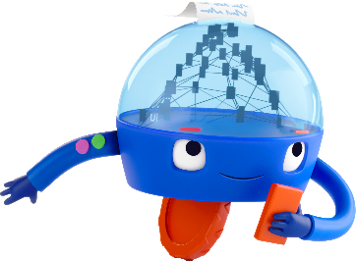
Software robots help Jane get work done faster & more accurately
Automation can help Jane…
Research
Take Action
Manage Data
Evaluate market trends
Measure financial risks
Perform financial forecasting
Conduct benchmarking analysis
Match payments with invoices
Track operational metrics
Onboard suppliers
Pre-populate documents for generating tax returns
Generate financial reports
Analyze transactions
Protect sensitive data
Identify non-compliant data
Plan
Get Organized
Start her day by logging into all applications
End her day by logging out of all applications
Schedule meetings
Automate her to-do list
Set up Out of Office replies
Submit expense reports
Check her benefits information

Slide 14
For example, robots help Jane create financial reports faster
BEFORE
AFTER
Jane spent 30% of her time to generate financial reports
With a digital assistant, Jane now spends 5% of her time on this task
100% human effort
100% robot effort
Open NetSuite
Robot generate 15 NetSuite reports with the automatic period and entity selection
Select an entity and dates and generate 15 reports (e.g. balance sheet, income statement)
Robot downloads reports
As a result, Jane..
Download reports
Robot formats reports and consolidates them in one pack that is presented to Jane
Repeat report generation for each entity
Created financial reports 6x faster and more accurately
Format report in Excel
Report generation completed
Report generation completed
Spent more time analyzing reports instead of copying & pasting data
1 app
1 step
1 click
Jane gets time back to spend on higher-value work – like performing financial reviews
Used extra time to identify business improvement opportunities
Multiple apps
5 steps
135+ clicks
No time left for high-value work

Slide 15
5 ways Jane can use automation in her daily work
1
2
3
Hand-off work to a robot
Work side-by-side with a robot
Engage with a robot before, after, or while it runs
Jane kicks off a robot. Robot takes control of her keyboard and mouse to complete a task.
A robot launches a copy of Jane’s desktop and runs in the background while she continues her work.
As a robot works on a task, it loops in Jane to make a decision, issue an approval, or for further analysis.
4
5
Automatically trigger a robot
Collaborate with robots that run and react to each other
A robot watches out for a specific action that occurs on Jane’s desktop. When the action occurs, it automatically starts running in the background.
A robot can trigger other robots to complete actions. Robots working together can efficiently complete one of Jane’s tasks.

Slide 16
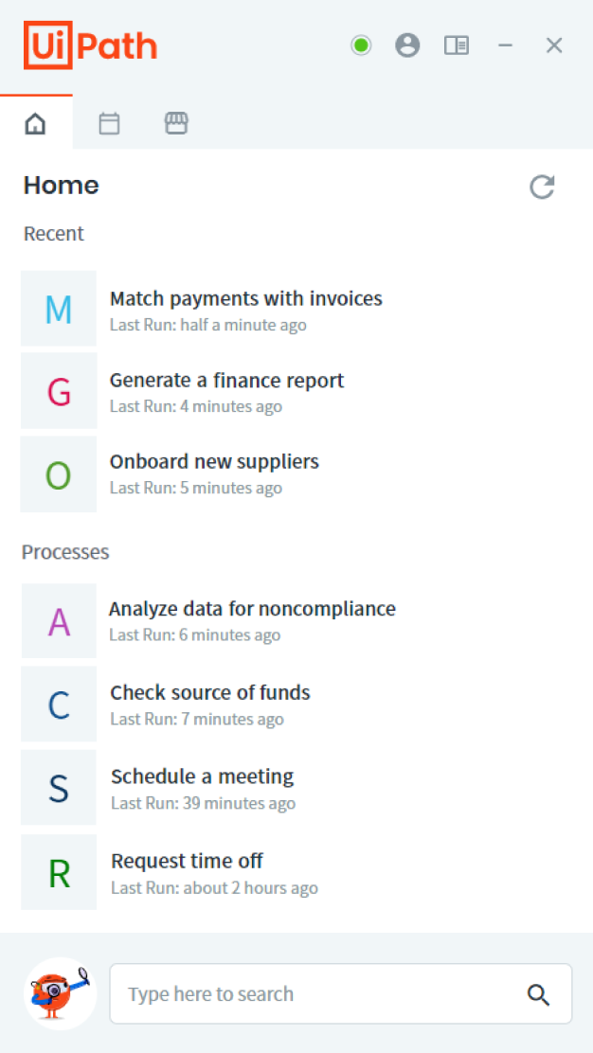
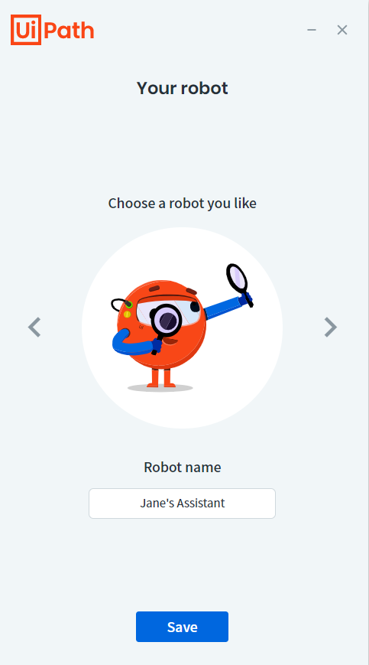
Jane launches automations directly from her desktop digital assistant
Simple, user-friendly automation experience for Jane and every employee in her organization
One click to automate mundane tasks across web and desktop apps
Fully governed by Jane’s organization to provide employees with secure, pre-approved automations
Can be shared with Jane’s colleagues who are using Mac computers (available in preview in Q4 2021)
UiPath Assistant

Slide 17
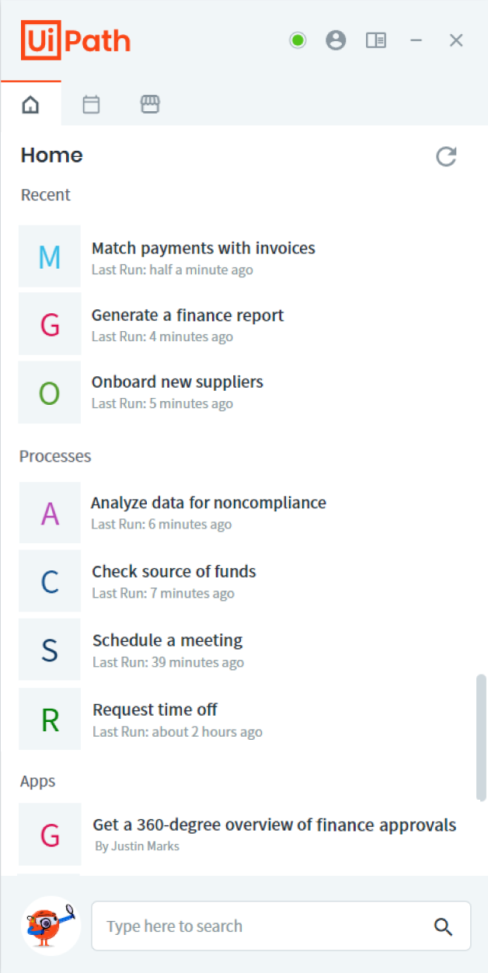
Jane’s digital assistant helps her with her work throughout the day
Automations like “generate a finance report” help Jane with tasks specific to her role
Automations like “schedule a meeting” help Jane plan & organize her day
Automation-powered apps help Jane get information from multiple systems in one place

Slide 18
Jane launches an automation-powered app from her assistant to make financial approvals easy
A single web interface for multiple processes across disparate systems, including older systems
Jane’s Finance Approval Dashboard
 | Approve | Return | Deny
 | Approve | Return | Deny
 | Approve | Return | Deny
 | Approve | Return | Deny
24 Total Pending Approvals | Approve All | Return All | Deny All
13 Pending Approvals
Access to automation on the go via mobile or tablet
5 Pending Approvals
2 Pending Approvals
Can be shared with Jane’s colleagues who are using Mac or Linux computers
Jane’s 30-Year-Old Mainframe System
4 Pending Approvals
UiPath Apps

Slide 19
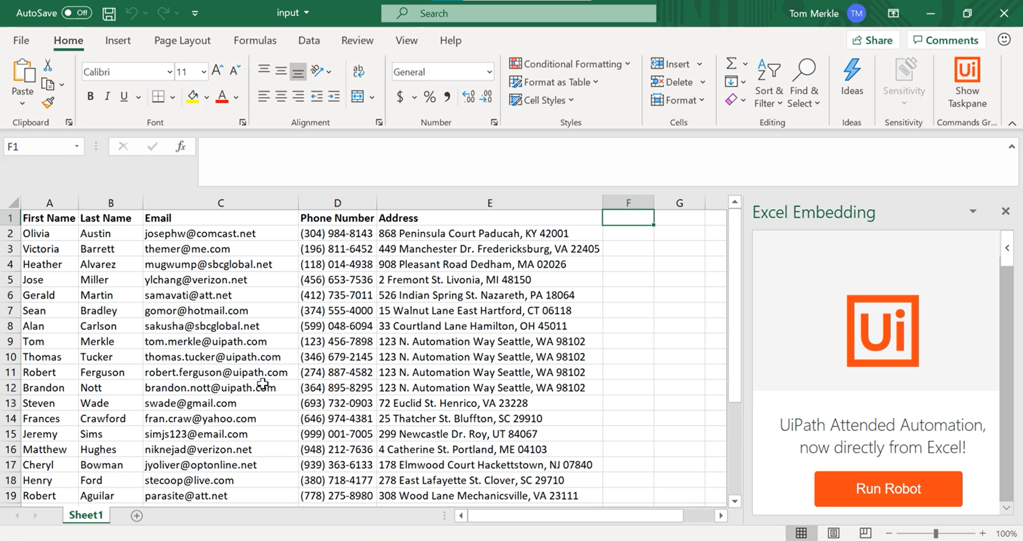
Jane interacts with automations directly in the enterprise tools she uses every day
Jane can launch and manage her automations directly from MS Teams
She can also talk to an HR Chatbot and ask for help with administrative requests, like creating an employment certificate
Whenever Jane is working on a budget report, she can run an automation directly from MS Excel.

Slide 20
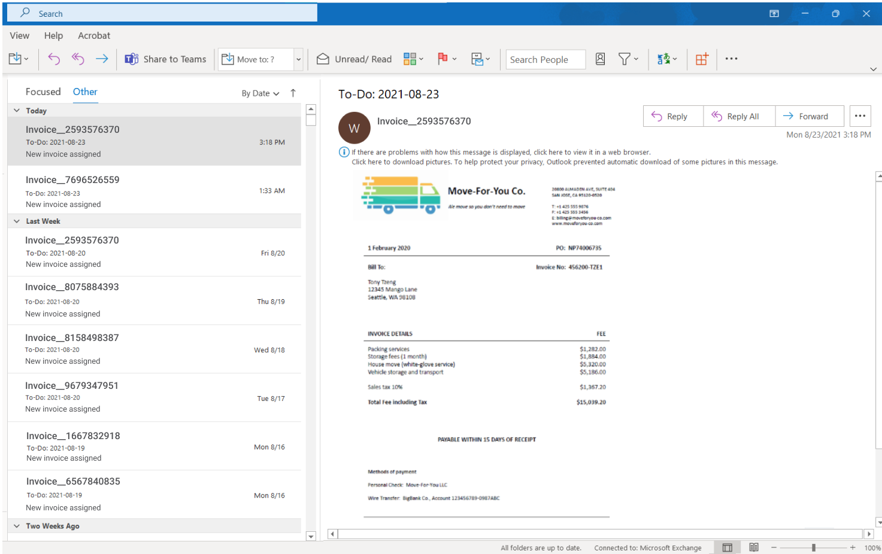
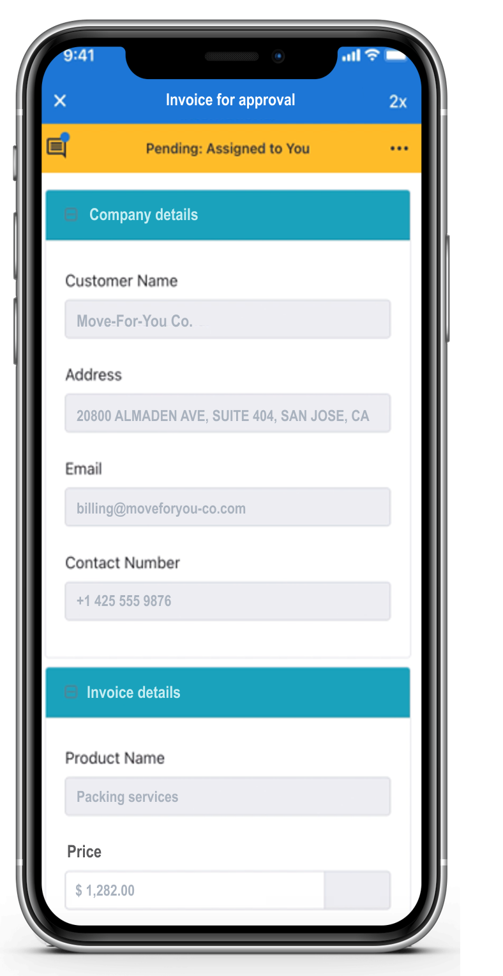
Jane’s assistant monitors incoming emails and automatically processes new invoices
A robot watches for a specific activity (e.g. when Jane receives a new email with a specific keyword) and runs an automation in the background
If a robot has a question or needs Jane’s validation, it will send her a note in Action Center (accessible via web or phone/tablet)

Slide 21
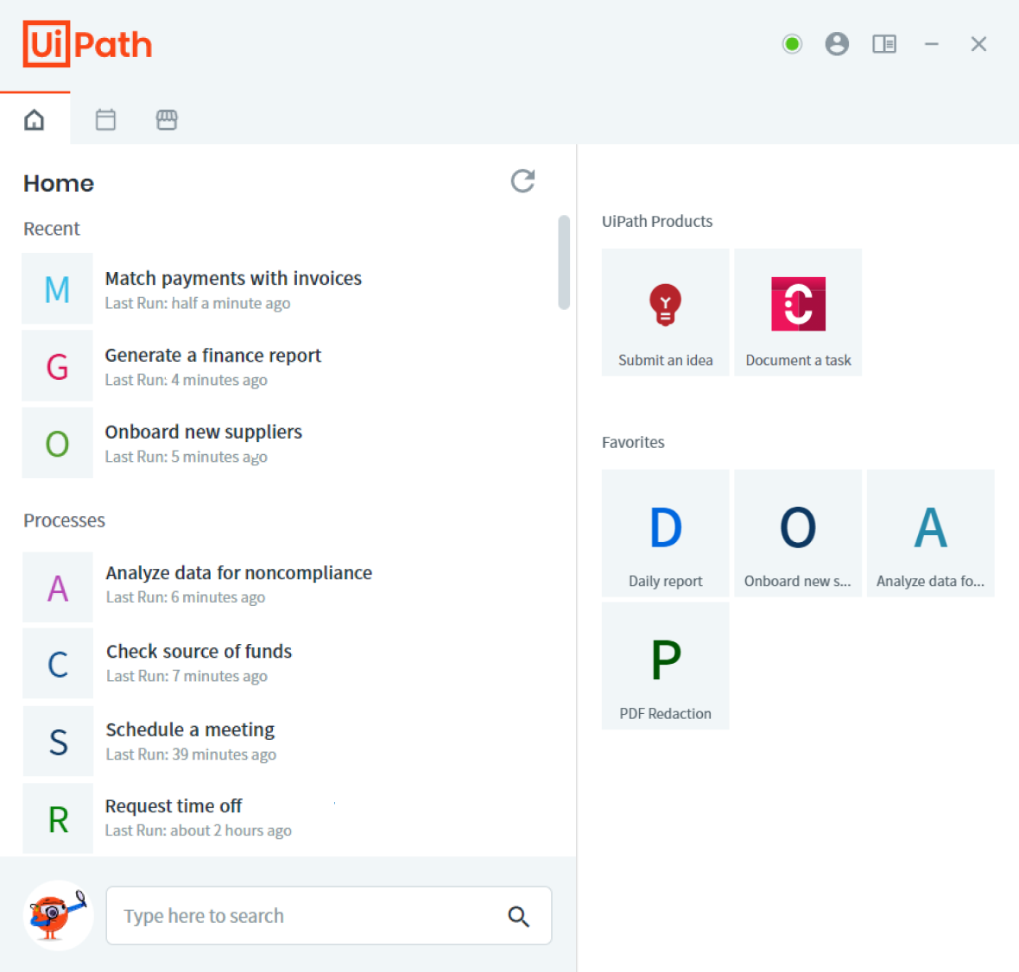
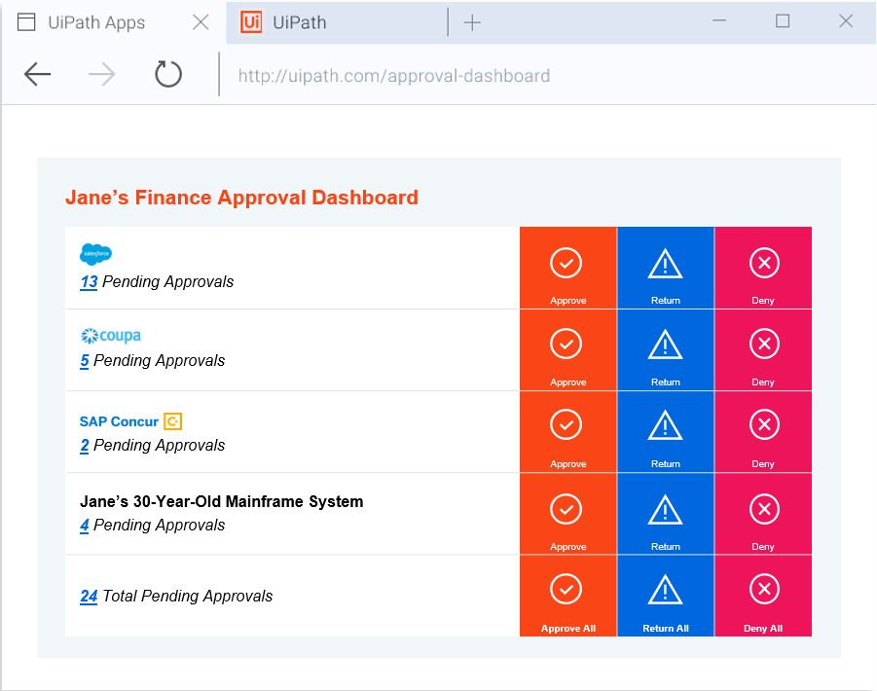
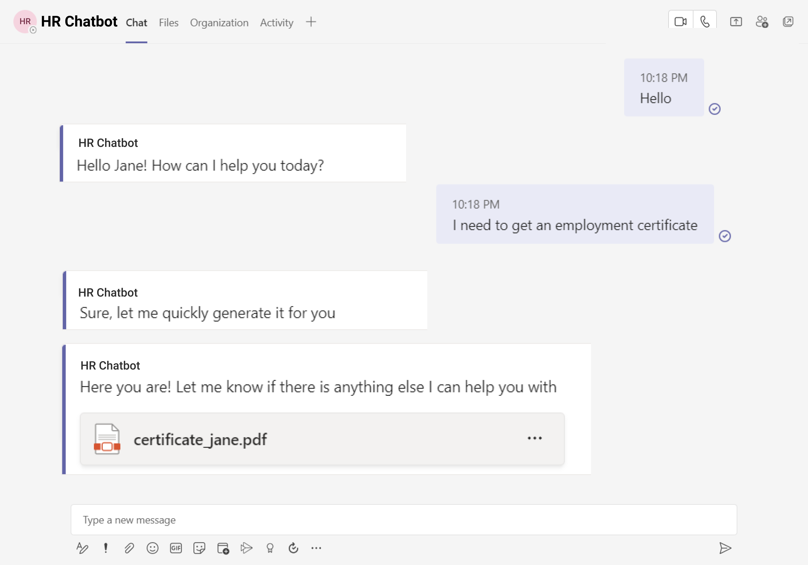
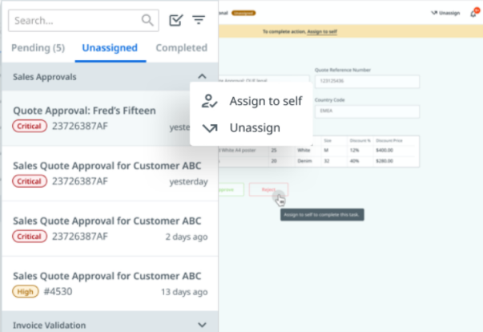
The UiPath platform makes it easy for Jane to work with automation
Run and manage automations from a launchpad
Interact with automation-powered apps
UiPath Assistant
UiPath Apps
Talk to AI-powered chatbots
Take action when robots need help
UiPath Chatbots
UiPath Action Center
Run and manage automations from Teams
Run automations from web and desktop tools
Native integration with MS Teams
Robot.JS & API

Slide 22
We strive to create a world-class experience for humans working with automation
The UiPath platform experience is:
Simple
Integrated
Scalable
Unified login
Common framework for automations
Built-in governance
Common design system
Flexible surfaces align with individual & team needs
True platform scale
Easy deployment
Easy access to a ready-to-go automation library
Drag & drop configuration

Slide 23
The leap to democratized development

Slide 24
People who work with robots want to build their own
Aspiring citizen developers are motivated by several drivers¹
30%
Productivity increase
79%
22%
Significant work can be automated, making time available for other tasks
of people who use automation want to become citizen developers – that is, build their own robots¹
20%
Bots help in reducing errors and increasing accuracy
19%
Bots provide enhanced value to customers / company
9%
Org./top mgmt. encourages use of RPA
UiPath and Bain & Company research, Overcoming the Automation Paradox

Slide 25
Automation consumption unlocks a continuous automation flywheel
4b
Employees build their own automations
4a
Employees submit automation ideas to CoE
The Center of Excellence (CoE) builds automation
Employees submit self-built automations to CoE
Employees use automations
3
1
5
Once employees start using automation, a breakthrough moment occurs: They can submit automation ideas to the CoE (4a) or build their own automations (4b)
CoE provides automations
to employees
2
CoE governs and share approved automations with other employees
6
Watch this short video to learn more about the automation flywheel

Slide 26
The 4 pillars of a fully automated enterprise™
At UiPath, we believe in a world where every company encourages robot-human collaboration
Provide a robot for every person in the company
Robot assistants augment and empower human workers
Democratize development
Workers can automate simple tasks with low-code apps
Assign automatable work to robots
Automation consumption at scale
Citizen development
Unleash AI across every facet of work
26

Slide 27
Bottom-up innovation that leads to business growth at scale
AIS upskilled 800 employees to develop their own automations. To date, there are now 560 automated processes, saving more than 409k hours annually.
Firstsource enabled more than 1000 employees to use and create automations. For example, one robot saves 460 days worth of employee hours each year.
Coke Canada Bottling believes in unlocking the power of people with the help of digital workers. The company provides citizen developers with access to RPA tools to help them automate business processes that directly affect their roles.

Slide 28
Making ‘a robot for every person’ and ‘democratized development’ a reality

Slide 29
Key factors that contribute to successful program execution at scale
Define personas
Set up governance policies
Define steps to execute the automation program
Configure technologies to align with program needs
Drive adoption

Slide 30
Define personas
Set up governance
Define execution steps
Configure technologies
Drive adoption
Personas involved in your automation program
End-to-End Governance
Automation Consumption
Automation Development
Automation Users
Employees suggest ideas and use automations that are provided
Citizen Developers
(Self Users)
Tech-savvy employees develop automations for themselves
Citizen Developers
(Expert Users)
Tech-savvy employees develop automations for themselves and their departments
RPA Developers
Create and test automations that are distributed throughout the company
CoE
Centrally governs self-service automations and facilitates company-wide rollouts, collaborating with IT

Slide 31
Central oversight and control
Define personas
Set up governance
Define execution steps
Configure technologies
Drive adoption
Automation consumption
Citizen development
Centrally push pre-approved automations to employees' desktops according to their role/department
Crowdsource and manage your automation pipeline in Automation Hub
Manage and share ready-to-use automations in your internal Automation Store
Review, validate and distribute citizen-led automations in Automation Hub
Create and manage enterprise-wide policies for citizen development
Align all citizen-led automations with your development standards (e.g. automatic code review)
Keep an administrative oversight of your program—and track automation adoption and other KPIs

Slide 32
Scale automation top-down & bottom-up
Define personas
Set up governance
Define execution steps
Configure technologies
Drive adoption
Automation consumption
CoE
RPA Developers
CoE
Automation Users
Assesses & prioritizes automation – including employee suggestions
Build and test automations
Govern and determine distribution for automations (if applicable)
Use robots and apps in day-to-day work; suggest new automation ideas
Citizen-development
Self Users
Expert Users
Create task automations for themselves based on governance rules
Create digital assistants for team usage based on governance rules

Slide 33
Each persona leverages relevant technology
Define personas
Set up governance
Define execution steps
Configure technologies
Drive adoption
Automation Users
RPA Developers
Assistant (consume automations)
Apps (interact with automation-powered apps)
Chatbots (talk to AI-powered chatbots)
Automation Hub/Task Capture (suggest automation ideas)
Studio/Apps Studio (create professional automations or automation-powered apps)
Test Suite (test automations)
Automation Hub/Task Capture (leverage SME’s knowledge to build automations)
Citizen Development
CoE
StudioX (create automations: self-users)
Studio (create automations: expert-users)
Assistant (consume automations)
Apps (interact with automation-powered apps)
Automation Hub/Task Capture (suggest automation ideas)
Automation Hub (assess & prioritize automation ideas)
Orchestrator (deploy and manage automations)
Automation Ops (govern automation program)
Insights (track program success)

Slide 34
Maximize adoption at scale
Define personas
Set up governance
Define execution steps
Configure technologies
Drive adoption
Create top-down program support
Dentsu’s mission is to elevate human potential by integrating RPA and AI into every business process. They say that creating a long-term plan for an automation operating model and identifying sponsors to drive awareness and demand are crucial for every successful ‘a robot for every person’ implementation.
Set up a formal program with clear targets and KPIs
Incentivize employees with gamification and recognition
If applicable, allocate bandwidth for citizen developers
Drive ongoing education
Clearly communicate use cases for automation
Make it clear how employees will benefit from working with automation
Provide a mix of learning material including easy-to-understand tutorials, detailed guides, function-specific blogs
AIS recruited 16 automation champions from various business units and trained them to become certified automation experts. As a result, they were able to pass on their knowledge and helped upskill 800 new citizen developers.
Enable bottom-up innovation
Wärtsilä has more than 100 citizen developers that are actively contributing to developing automations and trained more than 900 people to become automation ambassadors. The company says that this resulted in creating a whole internal ecosystem and a community that now supports itself.
Empower employees to suggest their own automation ideas
Create internal communities to facilitate employee engagement
Organize hackathons to help employees get their first automations off the ground

Slide 36
Appendix…

Slide 37
Whatever your goal, you can get there faster by empowering your people to work with robots
If your goal is to…
Automation helps you…
Resulting in…
Scale Faster
Make better decisions faster, with accurate/complete data
Business KPIs (#/%/$)
Reduce Cost
Automate manual activities and time-consuming tasks
Operational Cost ($)
Grow Revenue
Reduce cycle time and capture additional revenue streams
Revenue ($)
Enhance Customer Experience
Provide better customer service and product interactions
CSAT Score (#)
Improve Compliance & Regulations
Build automations to business rules, ensuring compliance
Risk KPIs (#/%/$)
Build a Foundation for AI
Collect/clean/organize data for use in AI solutions
AI Models (#)
Elevate Employee Experience
Improve employee experiences and automate repetition
EESAT Score (#)

Slide 38
healthcare professional
A robot assistant for every…
Robots help…
Assess
Manage Data
Take Action
…providers verify insurance information with payers at scale
…data scientists aggregate information from various sources
…doctors assess patient risk
…doctors request & manage patient tests
…providers maintain continuity of care by maintaining patient data across systems
…providers maintain data across all systems in a manner compliant with all government policies
…clinical staff onboard new patients
…revenue cycle management process and check status on claims
…radiologists make faster recommendations to patients based on test data
…hospitals accelerate priority testing, such as for COVID-19
…clinical staff check in patients in a manner compliant with all government policies

Slide 39
telco professional
A robot assistant for every…
Robots help…
Assess
Manage Data
Take Action
…operations triage network outages
…network managers provision & update equipment
…supply chain managers monitor device inventory levels
…agents explain complex pricing information
…agents understand customer entitlements
…managers compile network data & reports
…agents manage customer billing inquiries
…field technicians enter & update case data
…staff identify fraud
…agents update customer information in bulk
…manage return authorizations
…agents with customer upsell & cross-sell
…agents place orders & take payments
…back-office workers process purchase & service orders
…technicians troubleshoot customer problems & escalations
…mobile testers test apps and devices
…supervisors assign & dispatch field service engineers
…staff provision new services & devices

Slide 40
government employee
A robot assistant for every…
Robots help…
Assess
Manage Data
Take Action
…caseworkers validate benefits qualifications for recipients
…service desk workers prioritize incoming requests
…cyber analysts prioritize security threats
…government leaders aggregate reporting data from disparate systems
…procurement analysts speed up accounting processes
…logistics analysts streamline supply chain processes
…caseworkers process new benefit applications or renewals
…analysts integrate data from multiple data sources into reports
…government workers update government IDs or drivers’ licenses
…revenue collection agents process transactions quickly and correctly
…caseworkers ensure citizens have access to the appropriate benefits and services
…public health officials provide a higher quality of care and with lower costs
…contact center agents offer real-time, accurate support for citizens
…IT teams manage security & access across agencies
…law enforcement agents provide better public safety
…maintenance crews ensure assets have higher availability and longevity

Slide 41
financial services professional
A robot assistant for every…
Robots help…
Assess
Manage Data
Take Action
…investment bankers extract data from third-party providers to prepare pitch decks
…consumer banking teams automate end to end analytics pipeline
…wholesale banking staff with analysis for treasury clients
…financial advisers prepare for client meetings
…risk and compliance teams collect evidence for AML, Fraud, Sanctions, & other Financial Crimes
…onboarding teams handle data from institutional clients
…global markets teams with trade, position, nostro, & account reconciliations
…underwriting teams ascertain and monitor credit worthiness for commercial loans, mortgage and retail products
…relationship management teams with CRM data validation, cleansing, and sales coverage processes
…customer service and branch teams manage customer requests, including fraud-related questions, application inquiries, account modifications, exception requests, fee waivers, and more
…sales & trading teams with trade bookings and allocation processes
…traders ensure post trade compliance with all regulatory processes
…Financial Advisors generate pitch books and proposals for current clients

Slide 42
lawyer
A robot assistant for every…
Robots help…
Assess
Manage Data
Take Action
…review conflict of interest documents
…compile royalties & trademark reports
…identify public information in due diligence & other compliance processes
…staff update internal policies
…with IP protection & compliance processes
…monitor regulatory documents for changes
…extract data from legal documents
…legal writers share content while concealing specific data or text
…map, extract and consolidate data from various internal sources
…with data retrieval & transfers
…with time monitoring on projects and legal matters and timesheet creation
…attorneys answer frequently asked questions from employees
…operationalize GDPR compliance processes
…legal staff generate and amend legal documents, like NDAs
…ensure compliance with export control laws and regulations
…apply legal department playbooks

Slide 43
contact center agent
A robot assistant for every…
Robots help…
Assess
Manage Data
Take Action
…agents get a 360-degree view of customer
…agents understand a customer’s sentiment
…agents find knowledge faster to resolve customer issues
…automate routine, high-volume customer requests
…guide agents through infrequent customer inquiries
…eliminate in-call & after-call data entry tasks
…update customer information across systems after each call
…increase compliance and data security by protecting sensitive data
…customers transfer between self-service channels and agents
…agents authenticate the caller
…agents answer customer inquiries
…provide agents with a contextual script to reduce training time
…reduce supervisor escalations
…agents recommend next best actions to customers
…agents detect and manage fraud
…supervisors manage onboarding, scheduling, and offboarding

Slide 44
human resources professional
A robot assistant for every…
Robots help…
Assess
Manage Data
Take Action
…perform background checks for prospective hires
…collect compensation data from various sources for benchmarking analysis
…sourcers & recruiters triage resumes
…recruiters organize candidate pipelines
…collate T&E data from multiple sources for entry into payroll systems
…update compensation information and distribute compensation letters to employees
…send onboarding emails to new hires
…set up onboarding training for new hires
…respond to employee queries & requests
…recruiters post & maintain job openings
…L&D staff maintain a learning calendar, review course credits, and issue certificates

Slide 45
finance professional
A robot assistant for every…
Robots help…
Assess
Manage Data
Take Action
…run credit check reports to assess customer credit
…identify potential auto-matches between open invoices and payments
…vendor maintenance teams with pre-checks for supplier onboarding
…aggregate data from various sources to create and generate reports
…accounts payable aggregate data for accrual journals
…analyze transactions and identify potential reclassifications
…tax teams pre-populate documents for generating tax returns
…compliance teams aggregate data for audits & analyze it for non-compliance
…collection agents compose and send dunning letters
…accounts payable clerks with PO, Invoice, and Receipt data entry into an ERP
…helpdesk agents swiftly resolve standard requests
…post journal entries into accounting system
…tax teams with e-filing tax returns into various tax jurisdiction portals

Slide 46
farmer
A robot assistant for every…
Robots help…
Assess
Manage Data
Take Action
…with market fluctuations
…with granary, rail head, dock hours and notifications
…with corporate information and announcements
…with grower meetings
…see future pricing
…with real time inventories
…view settlements and incoming revenue
…see expenses in feed, fertilizers, seeds, chemicals, fuel
…search and value inventory
…settle contracts
…automate delivery, eliminating paper and increasing speed
…accept bids and work orders
…plan revenue
…sign contracts digitally

Slide 47
insurance professional
A robot assistant for every…
Robots help…
Assess
Manage Data
Take Action
…underwriters extract data from clients and third-party to assess and price an insurance risk
…claims teams automate the collection of claims history and risk factors for fraud
…retirement and life advisors' analysis and model pension plans for clients
…global insights teams provide 360 view on clients, analysis on their needs plus new product, market and services requirements
…risk and compliance teams collect evidence for Conduct, AML, Fraud, Sanctions, & other Financial Crimes
…onboarding teams handle data across the value chain and monitor the quality and accuracy
… actuaries prepare data to optimize capitalization and reserving
…modelling teams collate, set and monitor pricing in line with performance
…relationship management teams with CRM data validation, cleansing, sales coverage processes and GDPR processes
… claims teams structure data to assess validity of the claim
…customer service teams manage customer documentation, customer requests, status updates, exception requests and more
…sales teams bind risks on customer or broker instructions
…underwriting assurance monitor compliance with all regulatory processes
…claims officers quickly take action to resolve an incident for a customer
…Reinsurance specialists generate reinsurance programs to transfer risk from Insurers

